Slide 1

Automated Data Analysis Framework
Unlocking insights from complex datasets with natural language. This presentation outlines our innovative framework for automated data analysis, converting your questions into actionable intelligence.

Slide 2
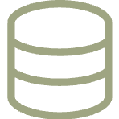


The Problem: Data Overload
Traditional data analysis can be slow and complex, often requiring specialised skills and manual intervention. Organisations need to quickly transform raw data into actionable insights to drive informed decisions.
Complex Datasets
Time-Consuming
Skill Gap
Navigating vast amounts of unstructured or semi-structured data.
Manual processes delay insight generation and decision-making.
Dependency on data scientists for basic analytical queries.

Slide 3
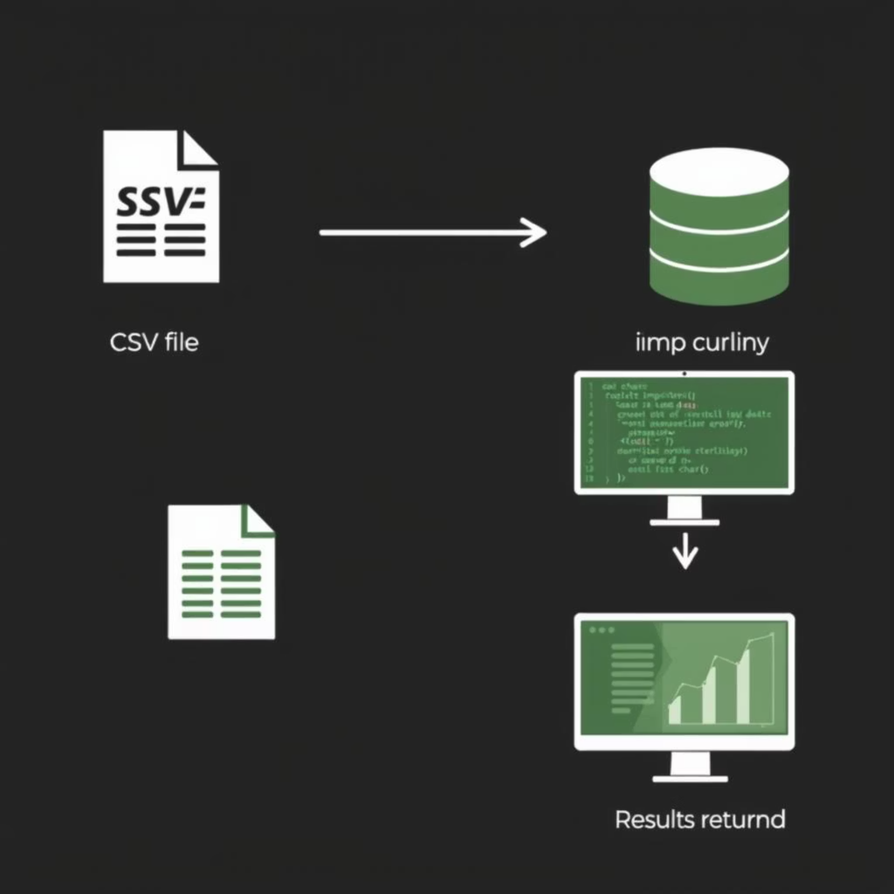
Our Solution: An Intelligent Framework
We've developed an automated data analysis framework that leverages AI to streamline the entire process, from data loading to natural language query execution.
Data Loading
Automated ingestion and standardisation of CSV/Excel files.
Natural Language to SQL
AI-powered conversion of questions into executable SQL.
Query Execution
Seamless execution using pandas and pandasql.

Slide 4

Key Component 1: Robust Data Loading
Our framework ensures efficient and accurate data ingestion, preparing your datasets for intelligent analysis.
Supported Formats
CSV files (Comma Separated Values)
Excel files (.xlsx, .xls)
Standardised Processing
Automatic column name standardisation
Data stored in accessible list of dictionaries format

Slide 5



Key Component 2: Natural Language to SQL
Leveraging the Gemini 2.5 Flash model, our agent transforms your questions into precise SQL queries, removing the need for coding expertise.
User Query
AI Interpretation
SQL Generation
"Average balance by gender, age, and job?"
Identifies key entities and relationships.
Creates optimized SQL for the dataset.

Slide 6
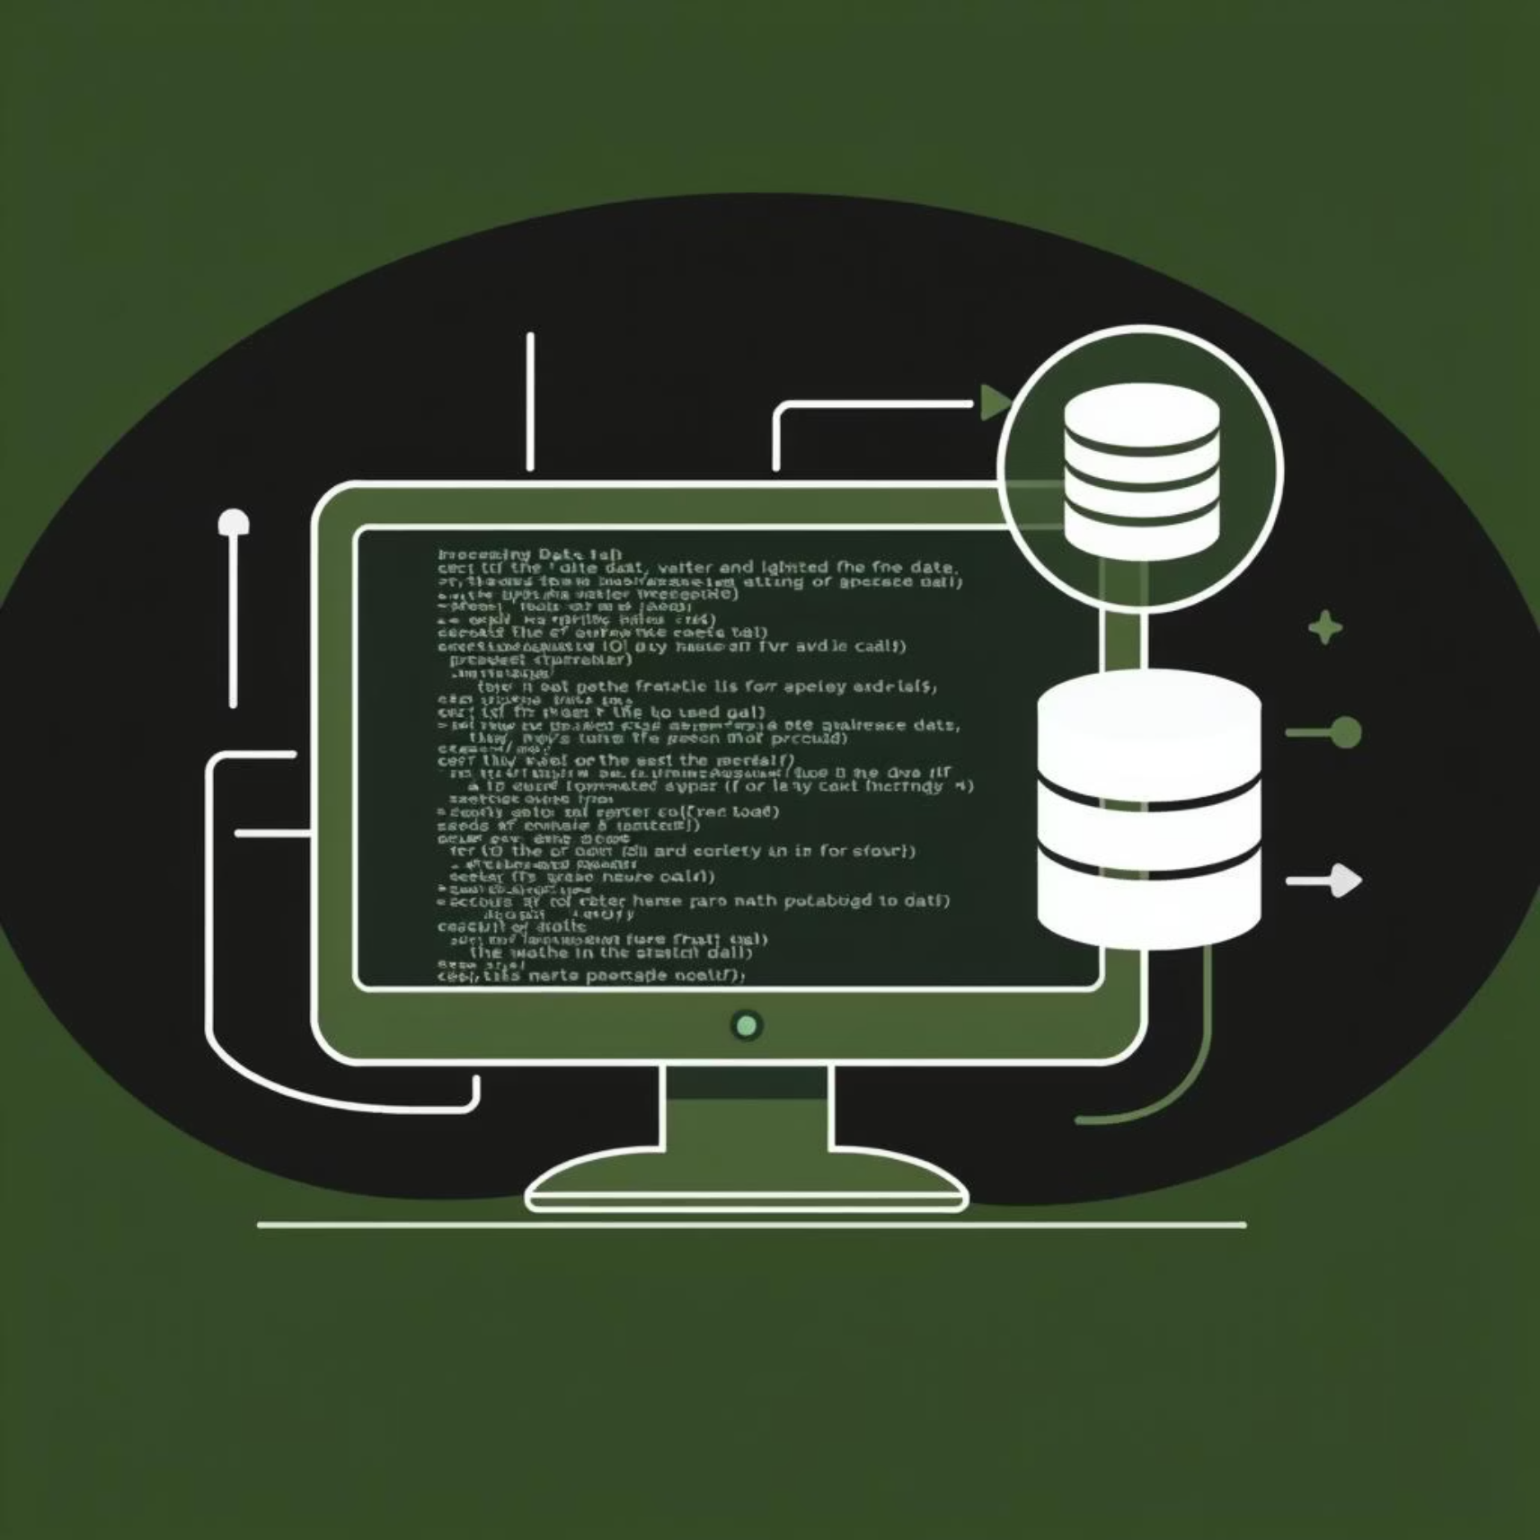
Key Component 3: Seamless Query Execution
The framework executes generated SQL queries efficiently using established libraries, providing results without direct user interaction with raw SQL.
Powered by Pandas and Pandasql
Robust and widely-used libraries ensure reliable execution.
Handles Complex Queries
Supports group-bys, aggregations, and special commands.
User-Friendly Interface
Abstracts away the technical complexities of SQL.

Slide 7


Demonstrated Use Cases
Our framework addresses practical analytical needs, providing valuable insights for business strategies.
Customer Segmentation
Geographic Distribution
"What is the average balance by gender, age group, and job classification?" This helps understand financial behaviour across demographics.
"Which region has the highest concentration of specific job classifications?" This reveals insights into market distribution.

Slide 8
Conclusion & Next Steps
Our automated data analysis framework offers a modular, scalable, and user-friendly solution for rapid data insights.
Key Takeaways
Next Steps
Quickly transforms natural language into data insights.
Schedule a live demo with your specific dataset.
Discuss customisation options for your industry.
Modular design for extensibility and adaptability.
Explore integration with existing business intelligence tools.
Ideal for complex, large-scale datasets, especially for CPG clients.

